Slide 1
Wine Quality Analysis
Viveka Cheekati

Slide 2
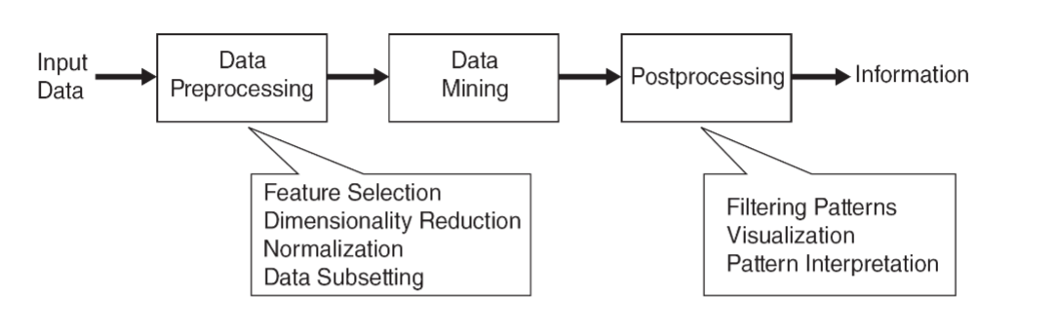

Introduction to Dataset

Slide 3
Red and White Wine Data
UC Irvine Machine Learning Repository
Portuguese “Vinho Verde”
Model Wine Quality

Slide 4
Red and White Wine Data
12 attributes
Fixed acidity, volatile acidity + 9 more
11 Continuous Quantitative Ratio
decimal
Quality (1-10)
1 Discrete Quantitative Ordinal
integer
2 datasets – 6497 records:
red: 1599 records
white: 4898 records
No missing or inapplicable values
No outliers

Slide 5
Input Features
fixed acidity
volatile acidity
citric acid
residual sugar
chlorides
free sulfur dioxide
total sulfur dioxide
density
pH
sulphates
alcohol

Slide 6



Data Preprocessing

Slide 7

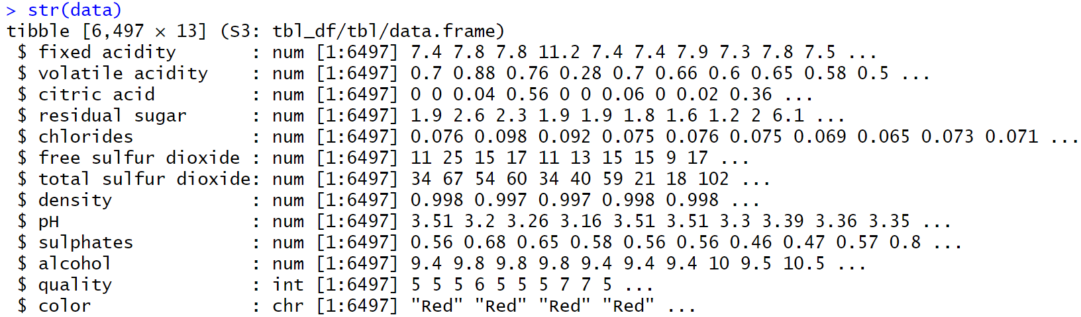
Data Manipulating
No missing values to handle
Add color attribute:
Discrete
Qualitative
Nominal
Full join datasets
Mutate quality from double/numeric to integer

Slide 8
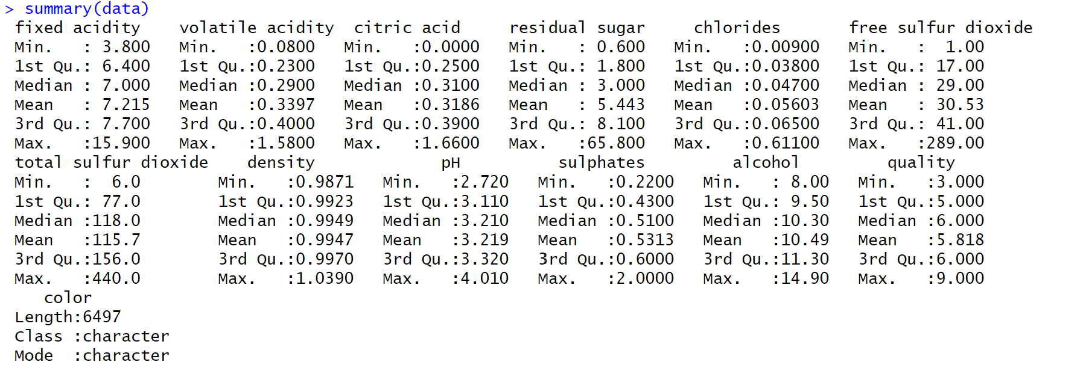
Summary of Data

Slide 9
Categorical Features
Color
Quality

Slide 10
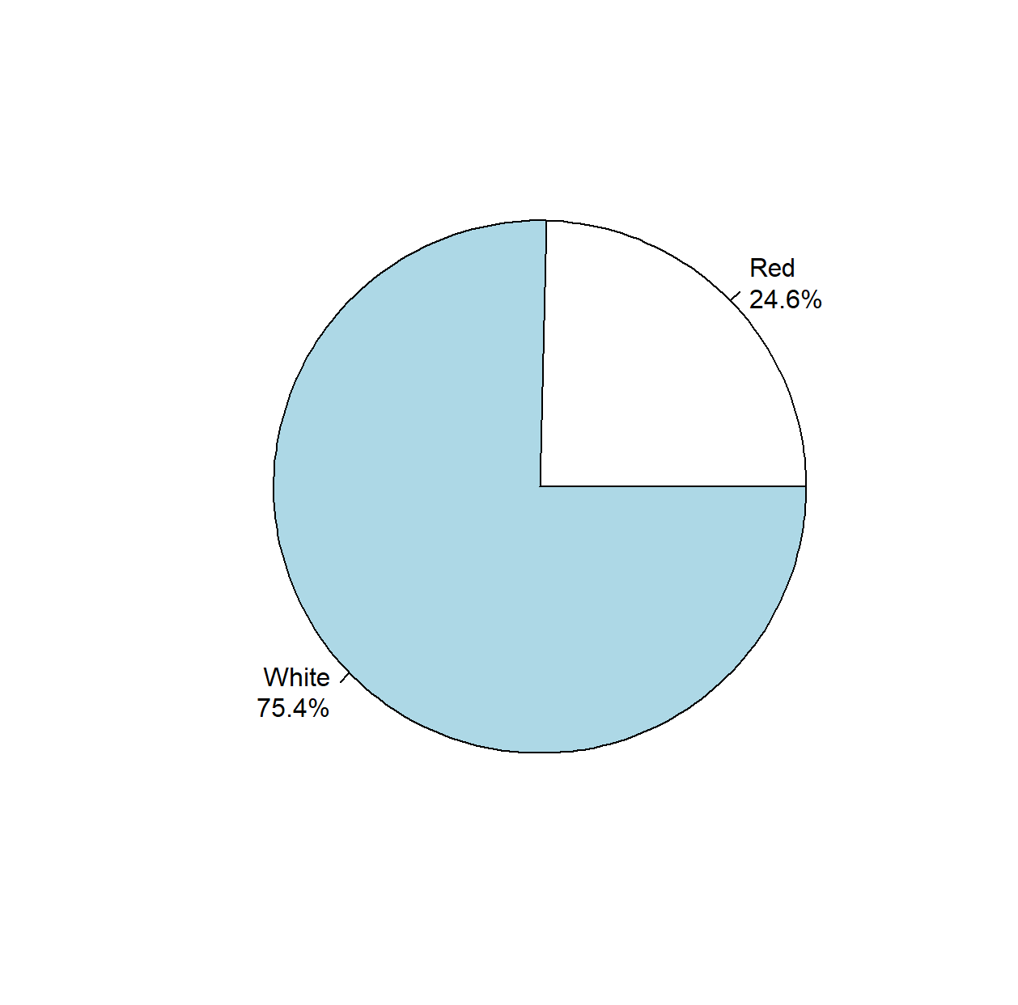
Distribution By Color

Slide 11
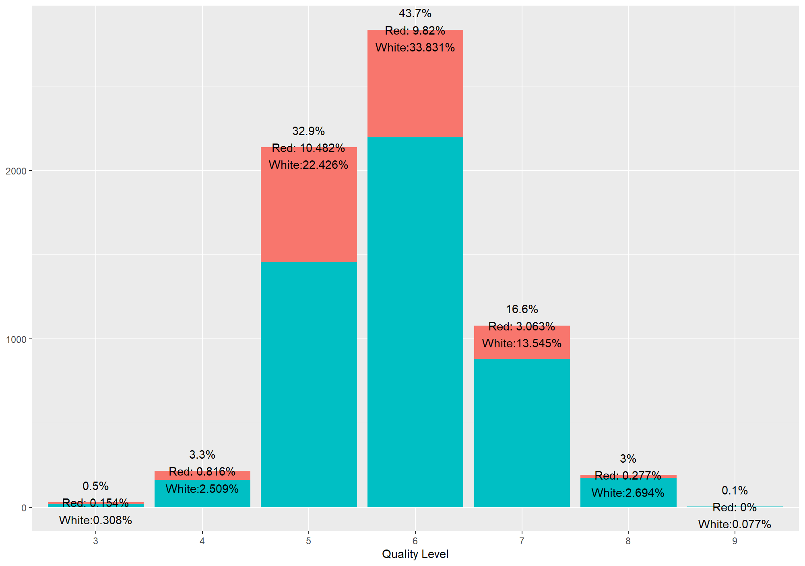
Distribution By Quality

Slide 12
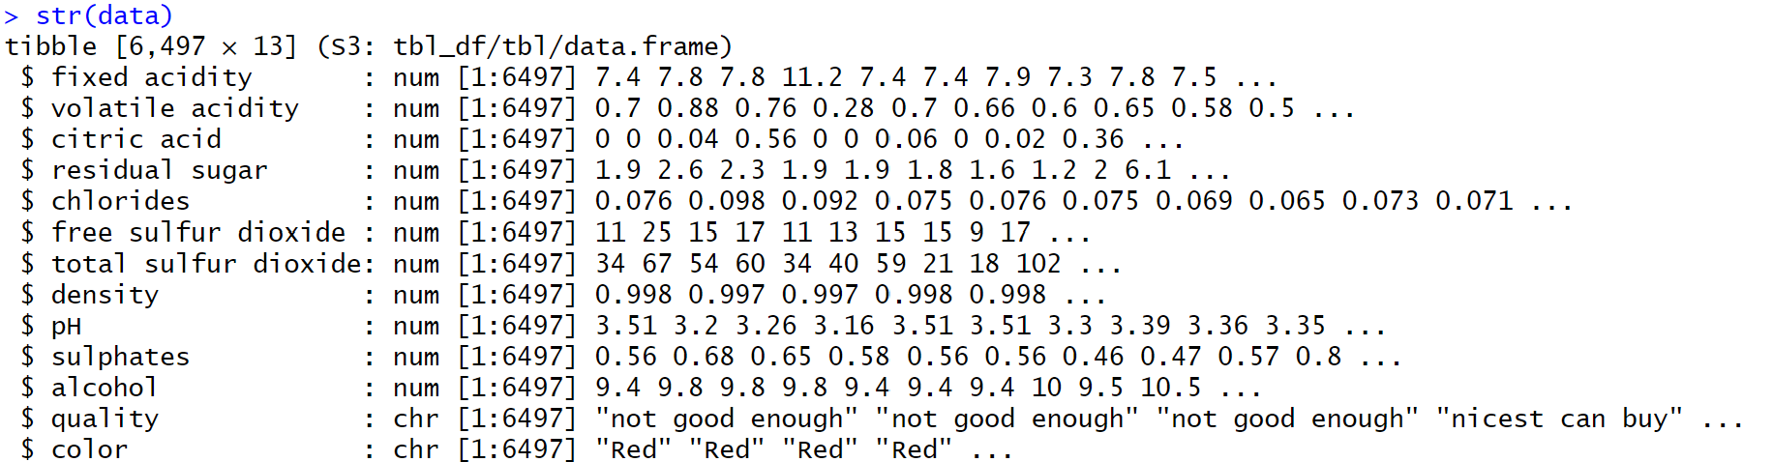
Balance Data
Mutate quality
Discrete Qualitative Nominal
If quality < 6,
“not good enough”
If quality = 6,
“nicest can buy”
If quality > 6,
“too expensive”

Slide 13
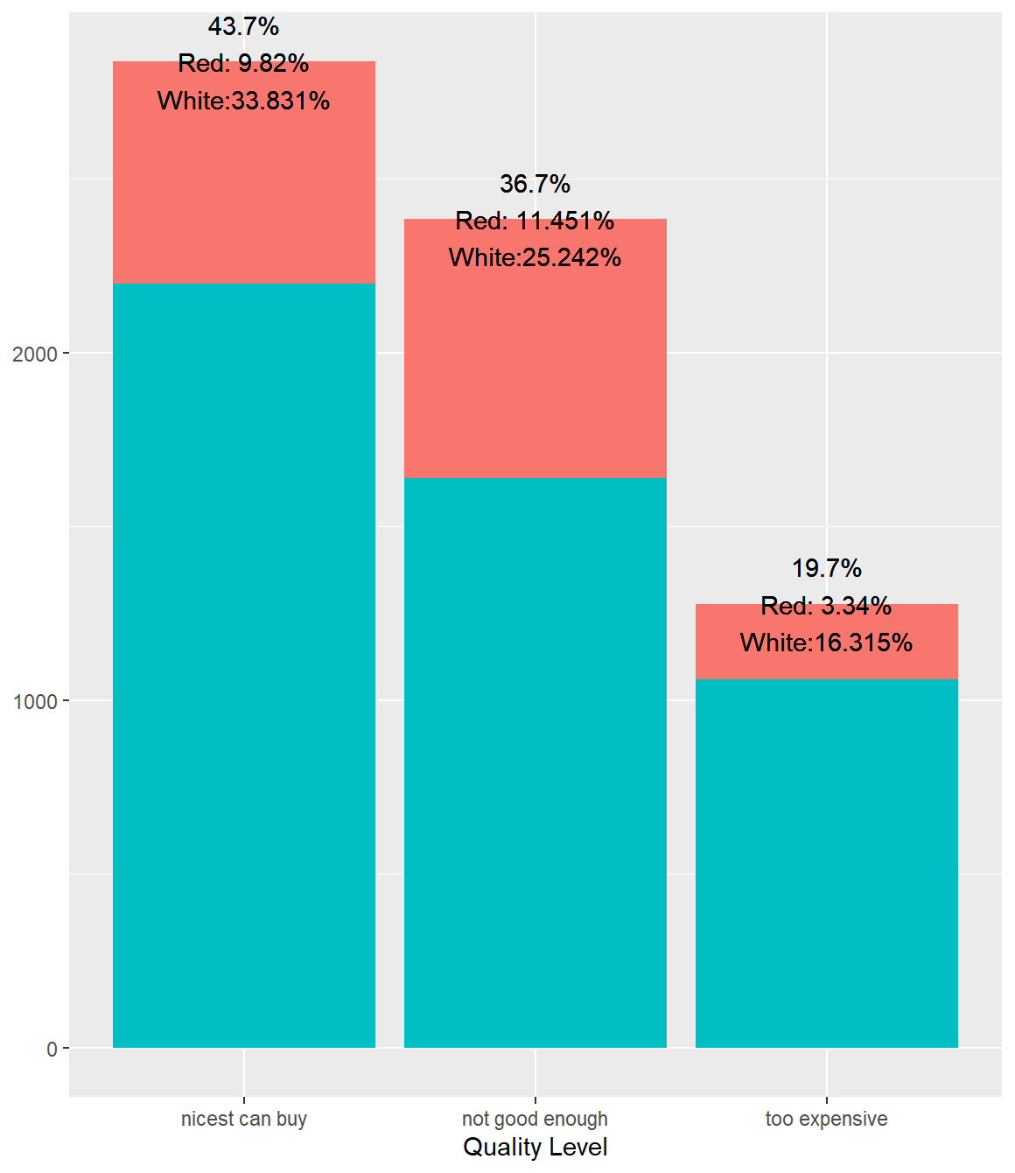
Distribution By Quality

Slide 14
Numeric Features
Correlation Heatmap
Scatterplot Matrix

Slide 15
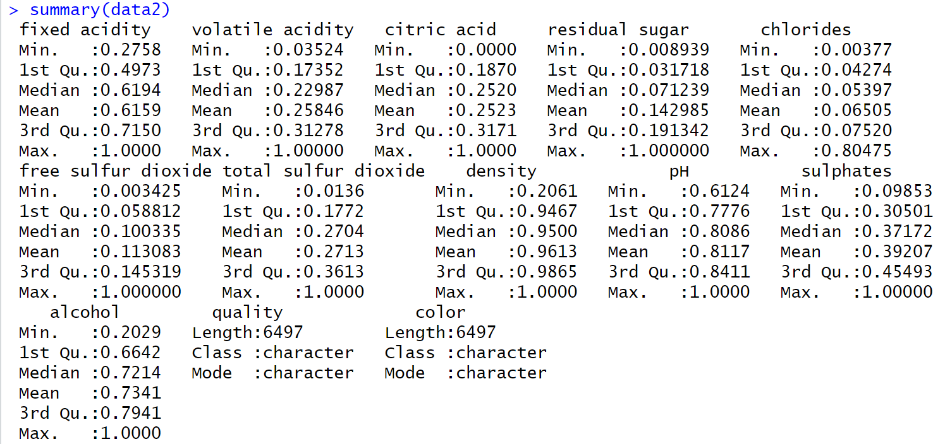

Normalize Numerics
Using the minimum and maximum of numeric columns
$\frac{x −x_{min}}{x_{max}− x_{min}}$

Slide 16
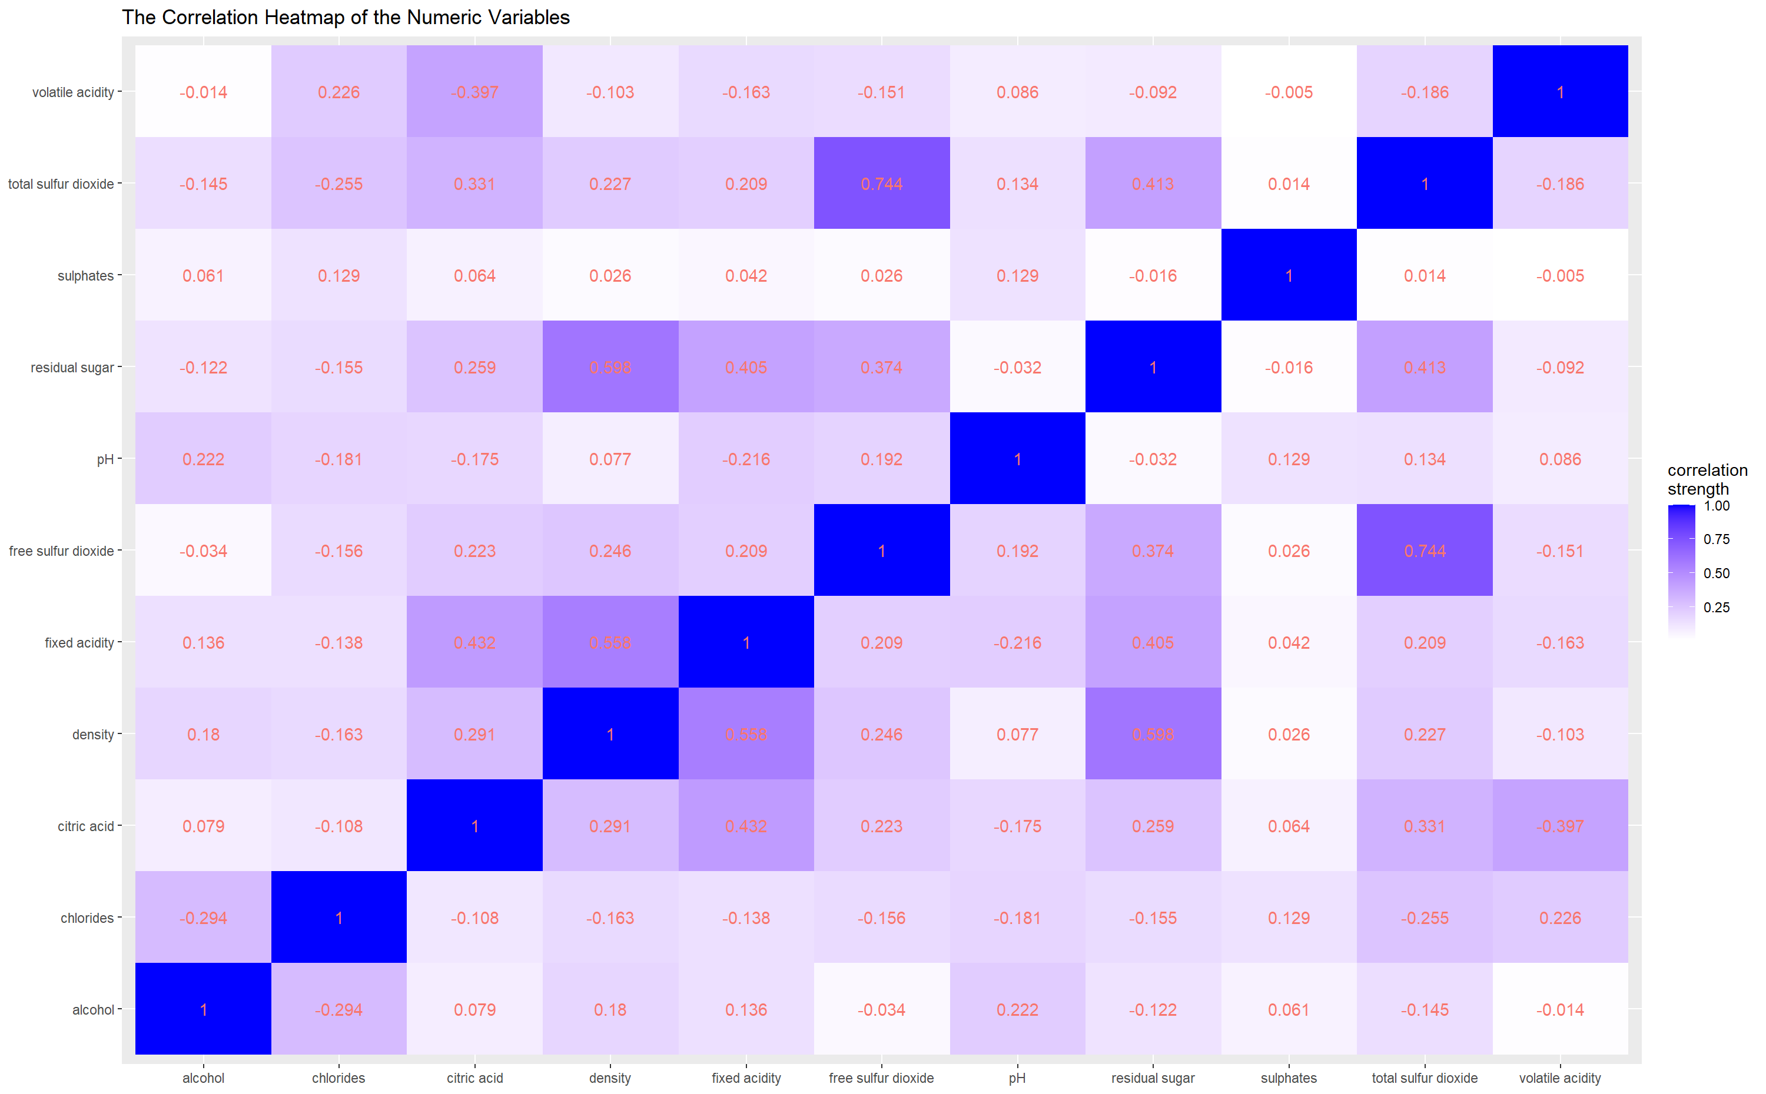
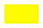


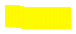


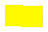
Correlation Heatmap

Slide 17
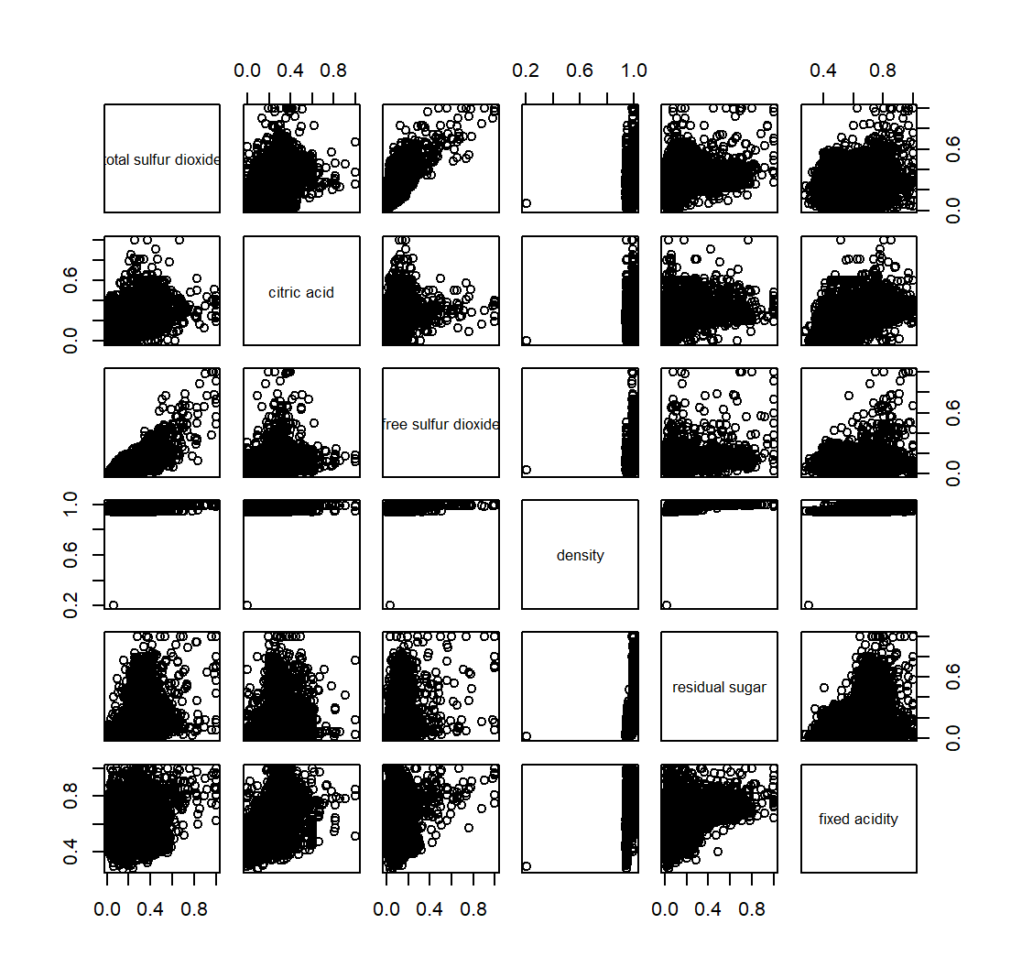








Scatterplot Matrix

Slide 18



Data Mining Algorithms

Slide 19
Classification
Decision Trees (2)
Random Forest

Slide 20
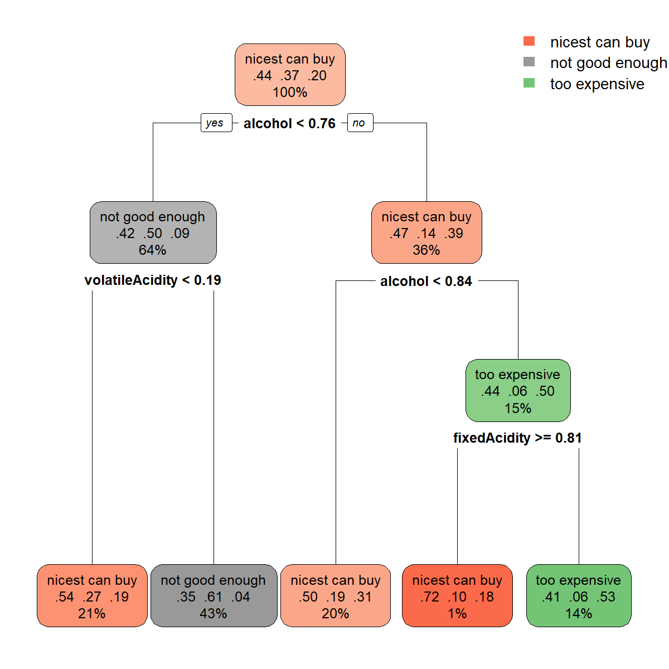
Decision Tree (1)

Slide 21
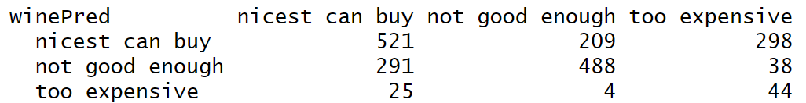



Decision Tree (rpart)
Testing Set
1918 rows
Accuracy = 54.9%
Precision:
nicest can buy = 50.68%
not good enough = 59.73%
too expensive = 60.27%

Slide 22
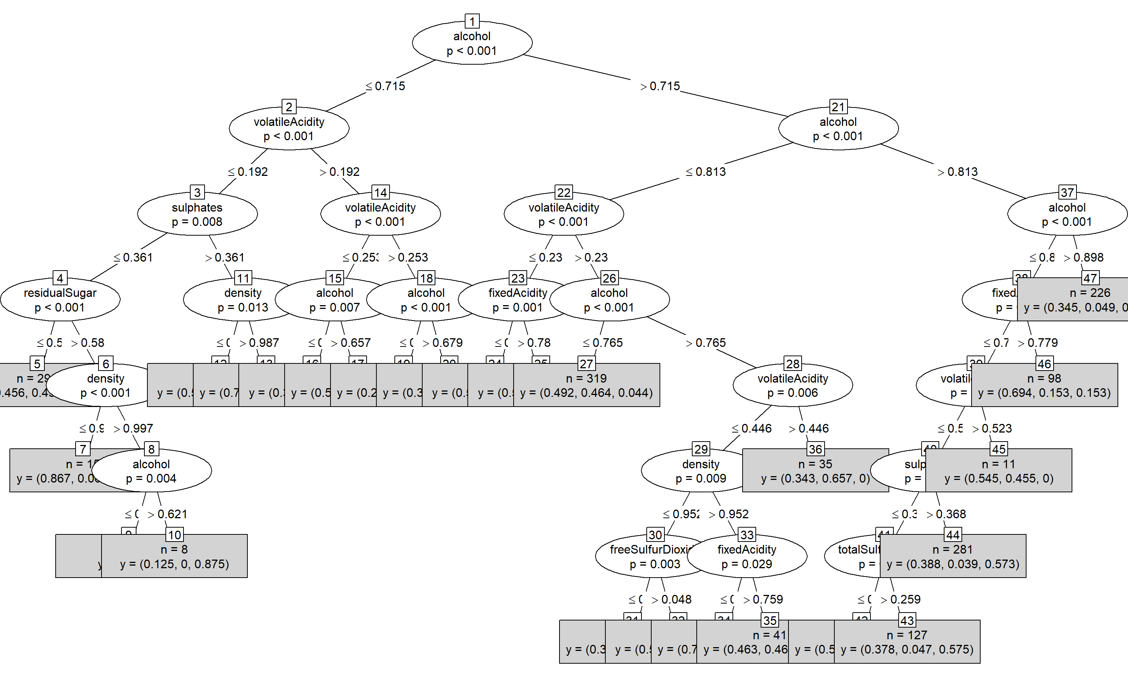
Decision Tree (2)

Slide 23
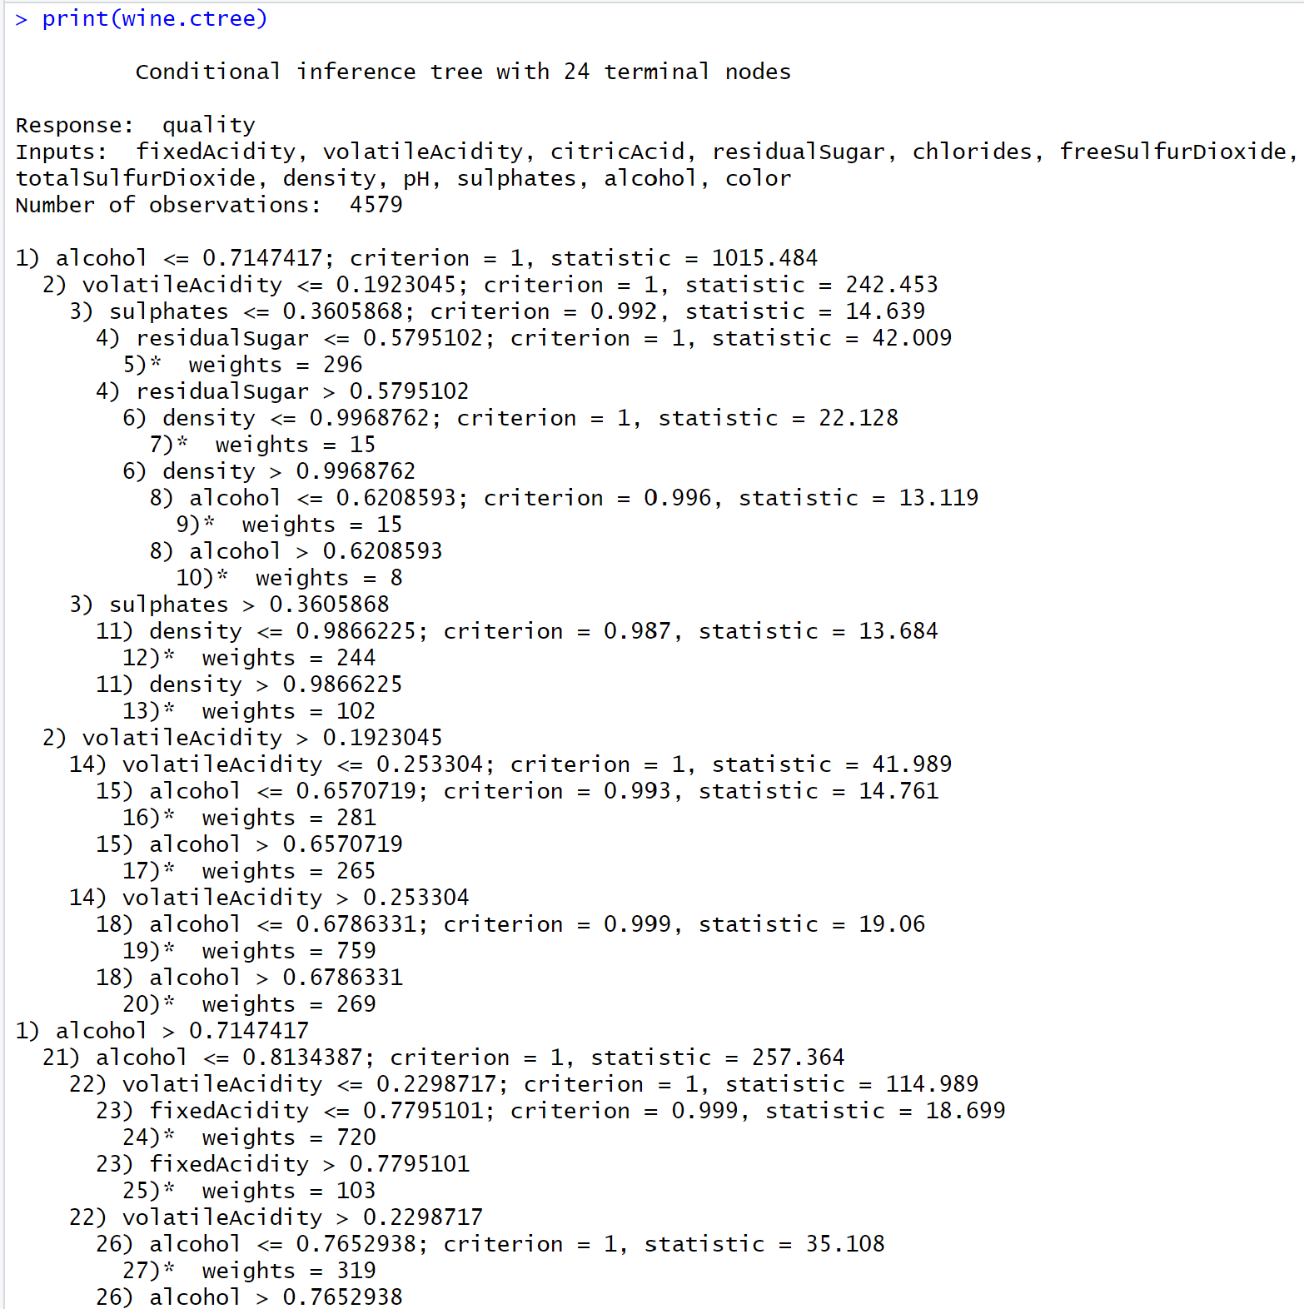
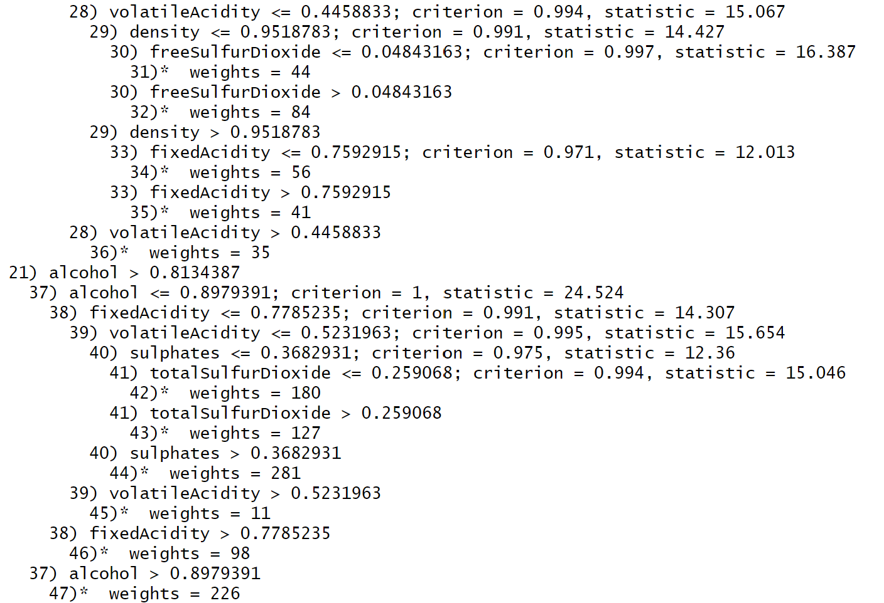
Decision Tree (ctree)

Slide 24
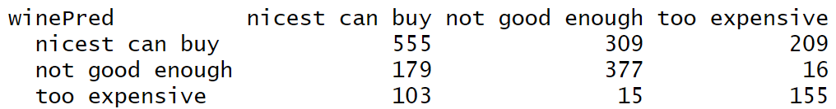



Decision Tree (ctree)
Testing Set
1918 rows
Accuracy = 56.67%
Precision:
nicest can buy = 51.72%
not good enough = 65.91%
too expensive = 56.78%

Slide 25
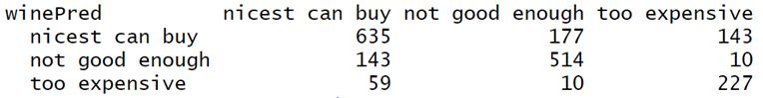



Random Forest

Slide 26
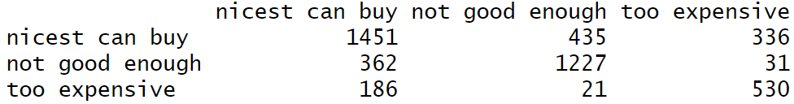
Random Forest
Training Set
4579 rows
Accuracy: 70.058%
Precision:
nicest can buy: 65.302%
not good enough: 75.741%
too expensive: 71.913%

Slide 27
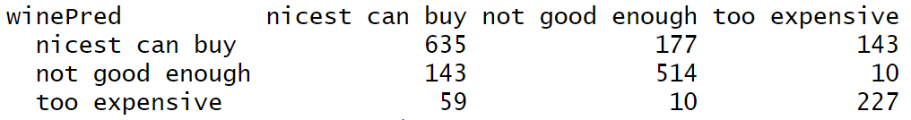



Random Forest
Testing Set
1918 rows
Accuracy: 71.741%
Precision:
nicest can buy: 66.492%
not good enough: 77.061%
too expensive: 76.689%

Slide 28
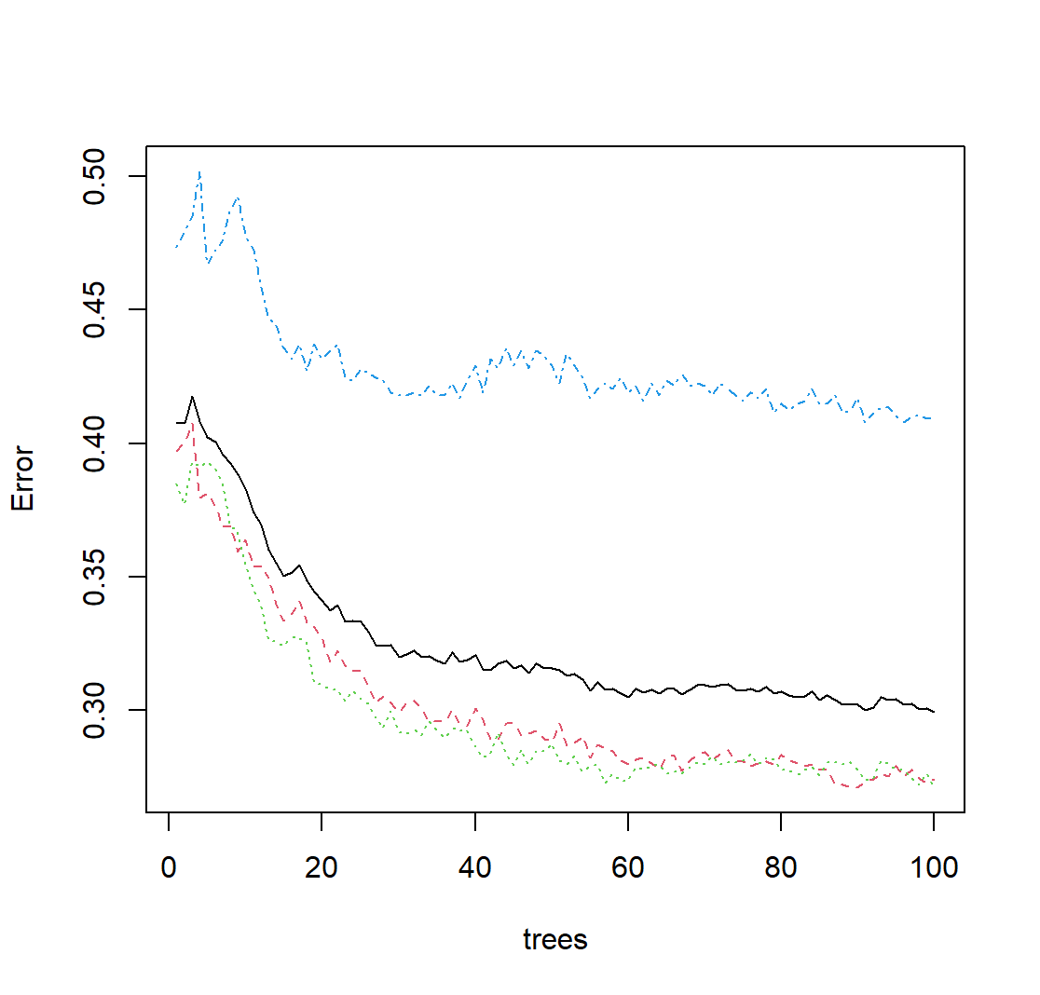
Random Forest
Error Rate

Slide 29
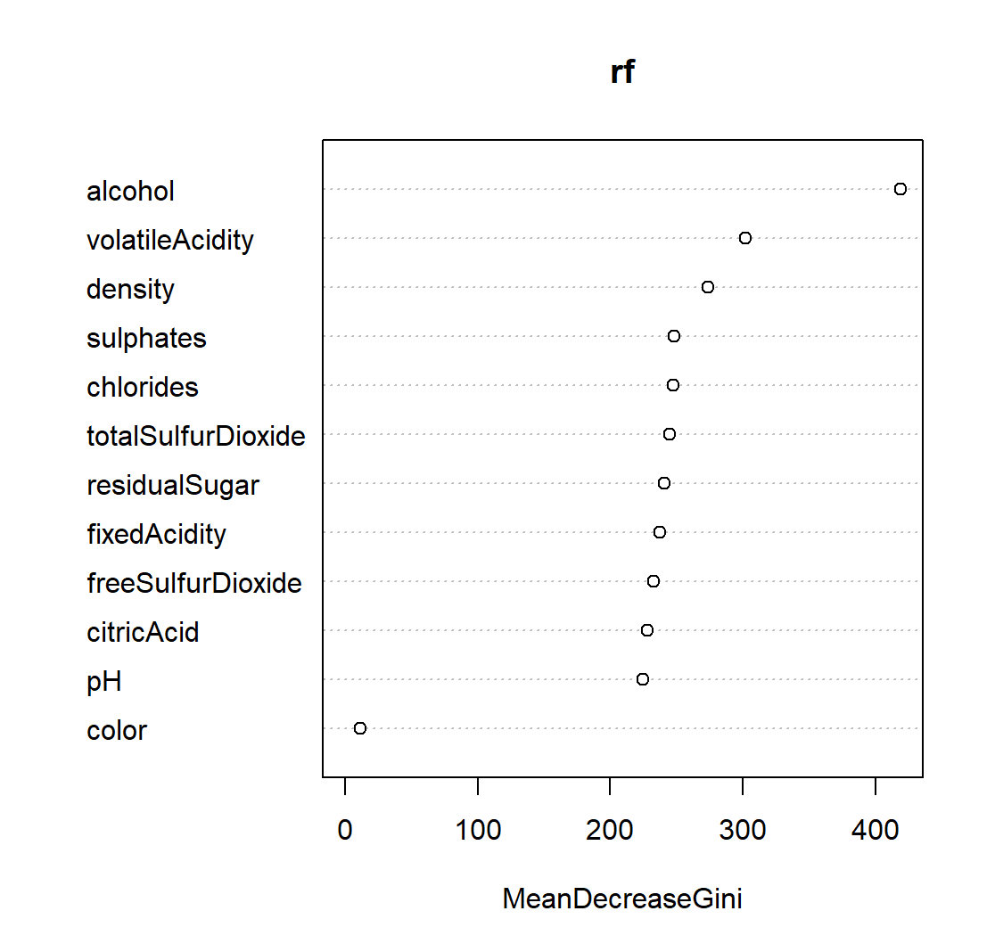
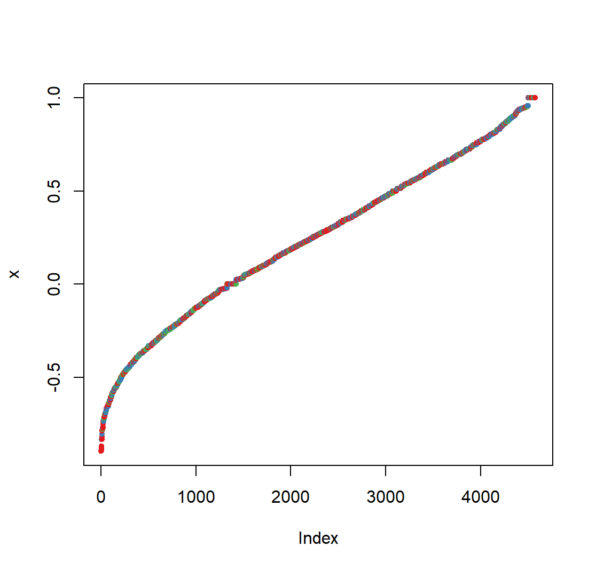
Random Forest
Variable Importance
… Plot

Slide 30
Clustering
kMeans
Hierarchical Clustering
Density-Based Clustering

Slide 31
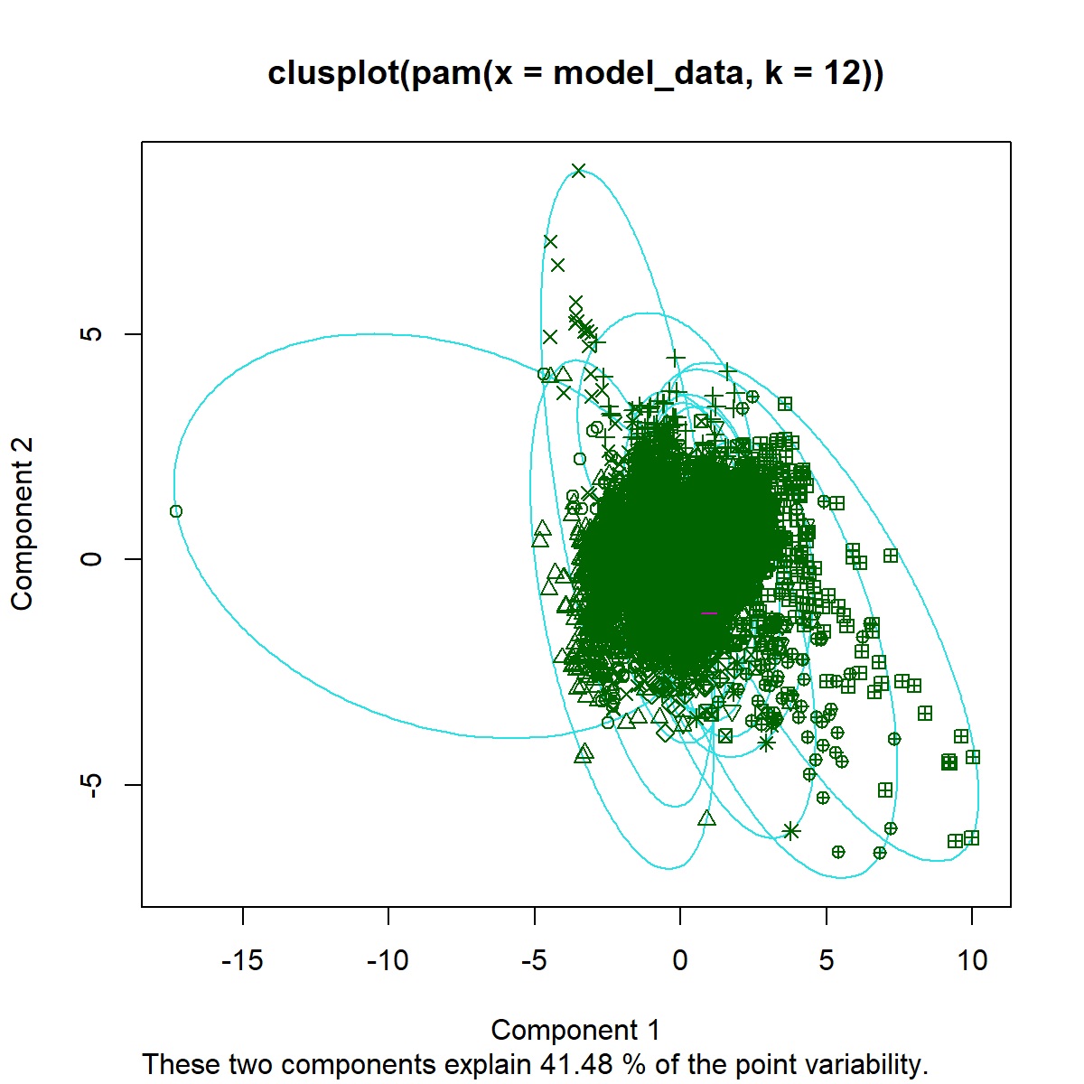
kMeans

Slide 32
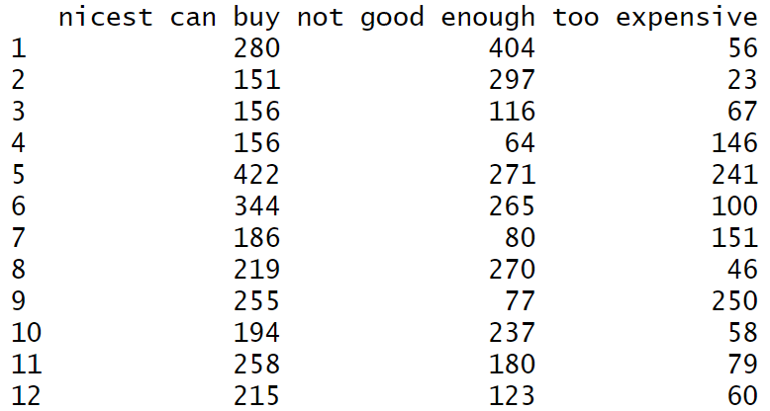
kMeans (pam)

Slide 33
kMeans (pam)
K | Sum of Squared Error
3 | 15,406,705
5 | 8,808,803
7 | 7,017,631
9 | 5,127,187
11 | 4,124,543
12 | 3,857,007
13 | 3,548,025

Slide 34
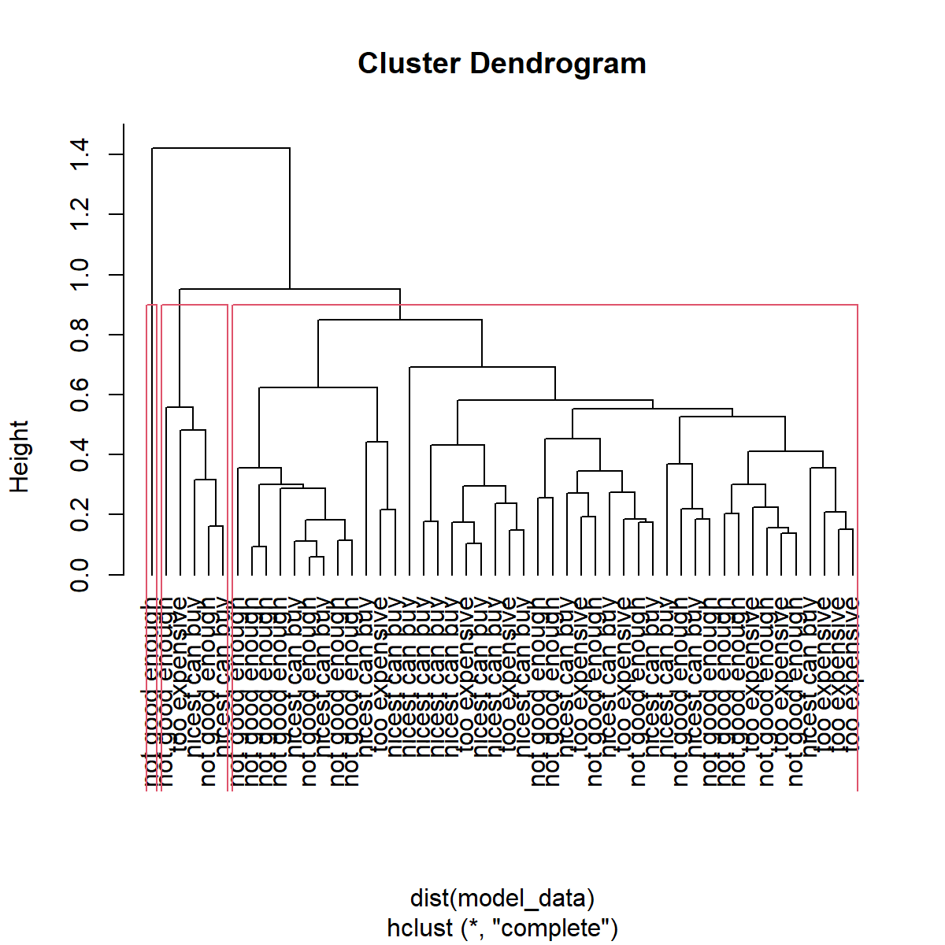
Hierarchical Clustering

Slide 35
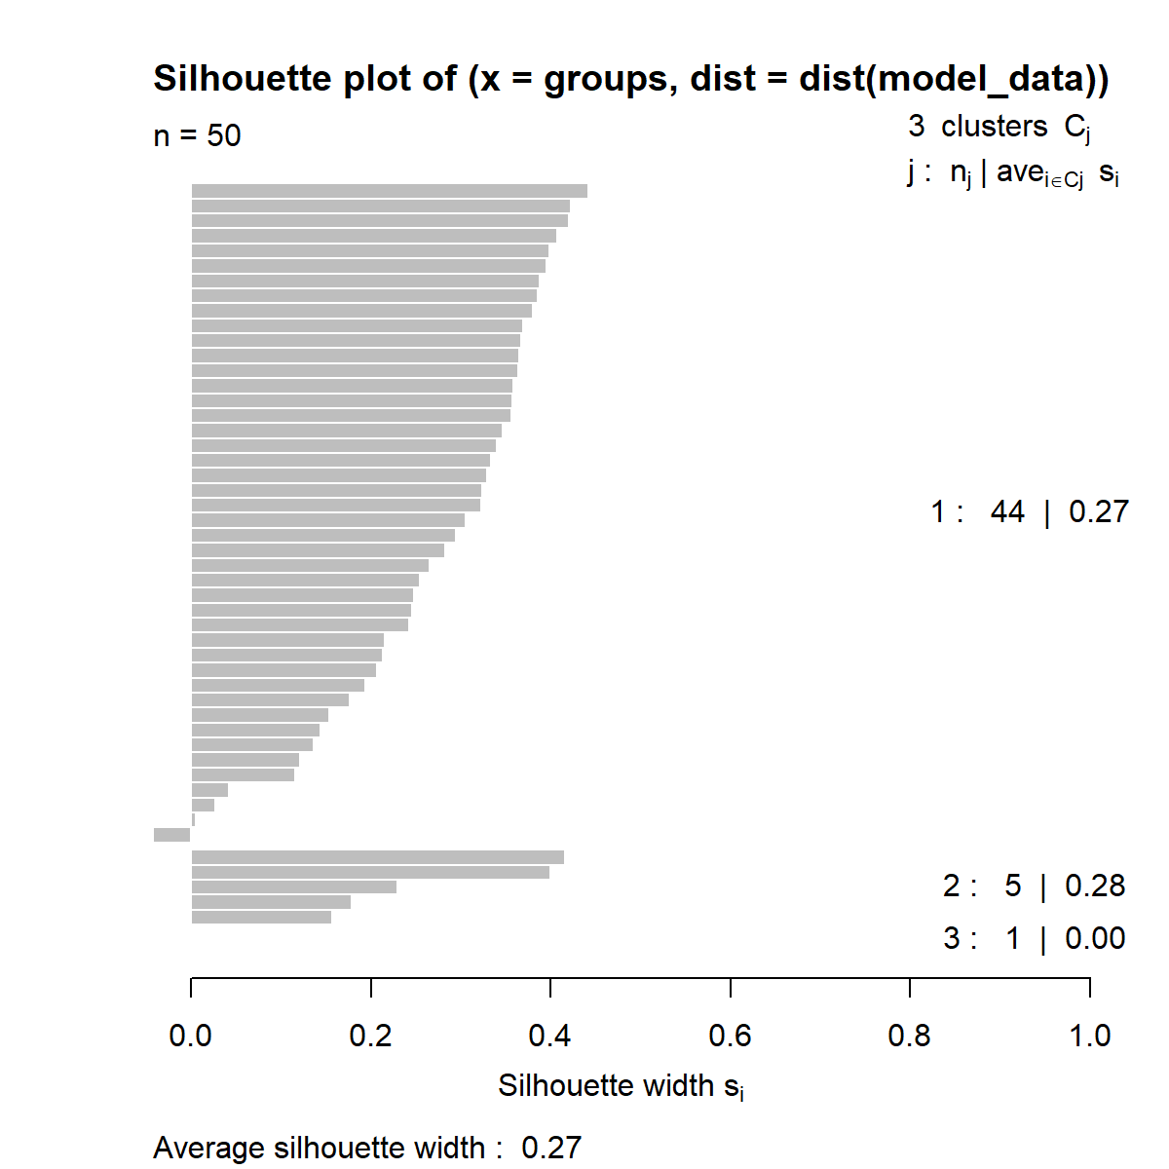
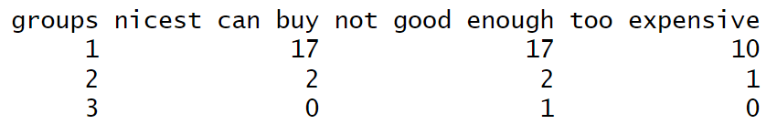
Hierarchical Clustering

Slide 36
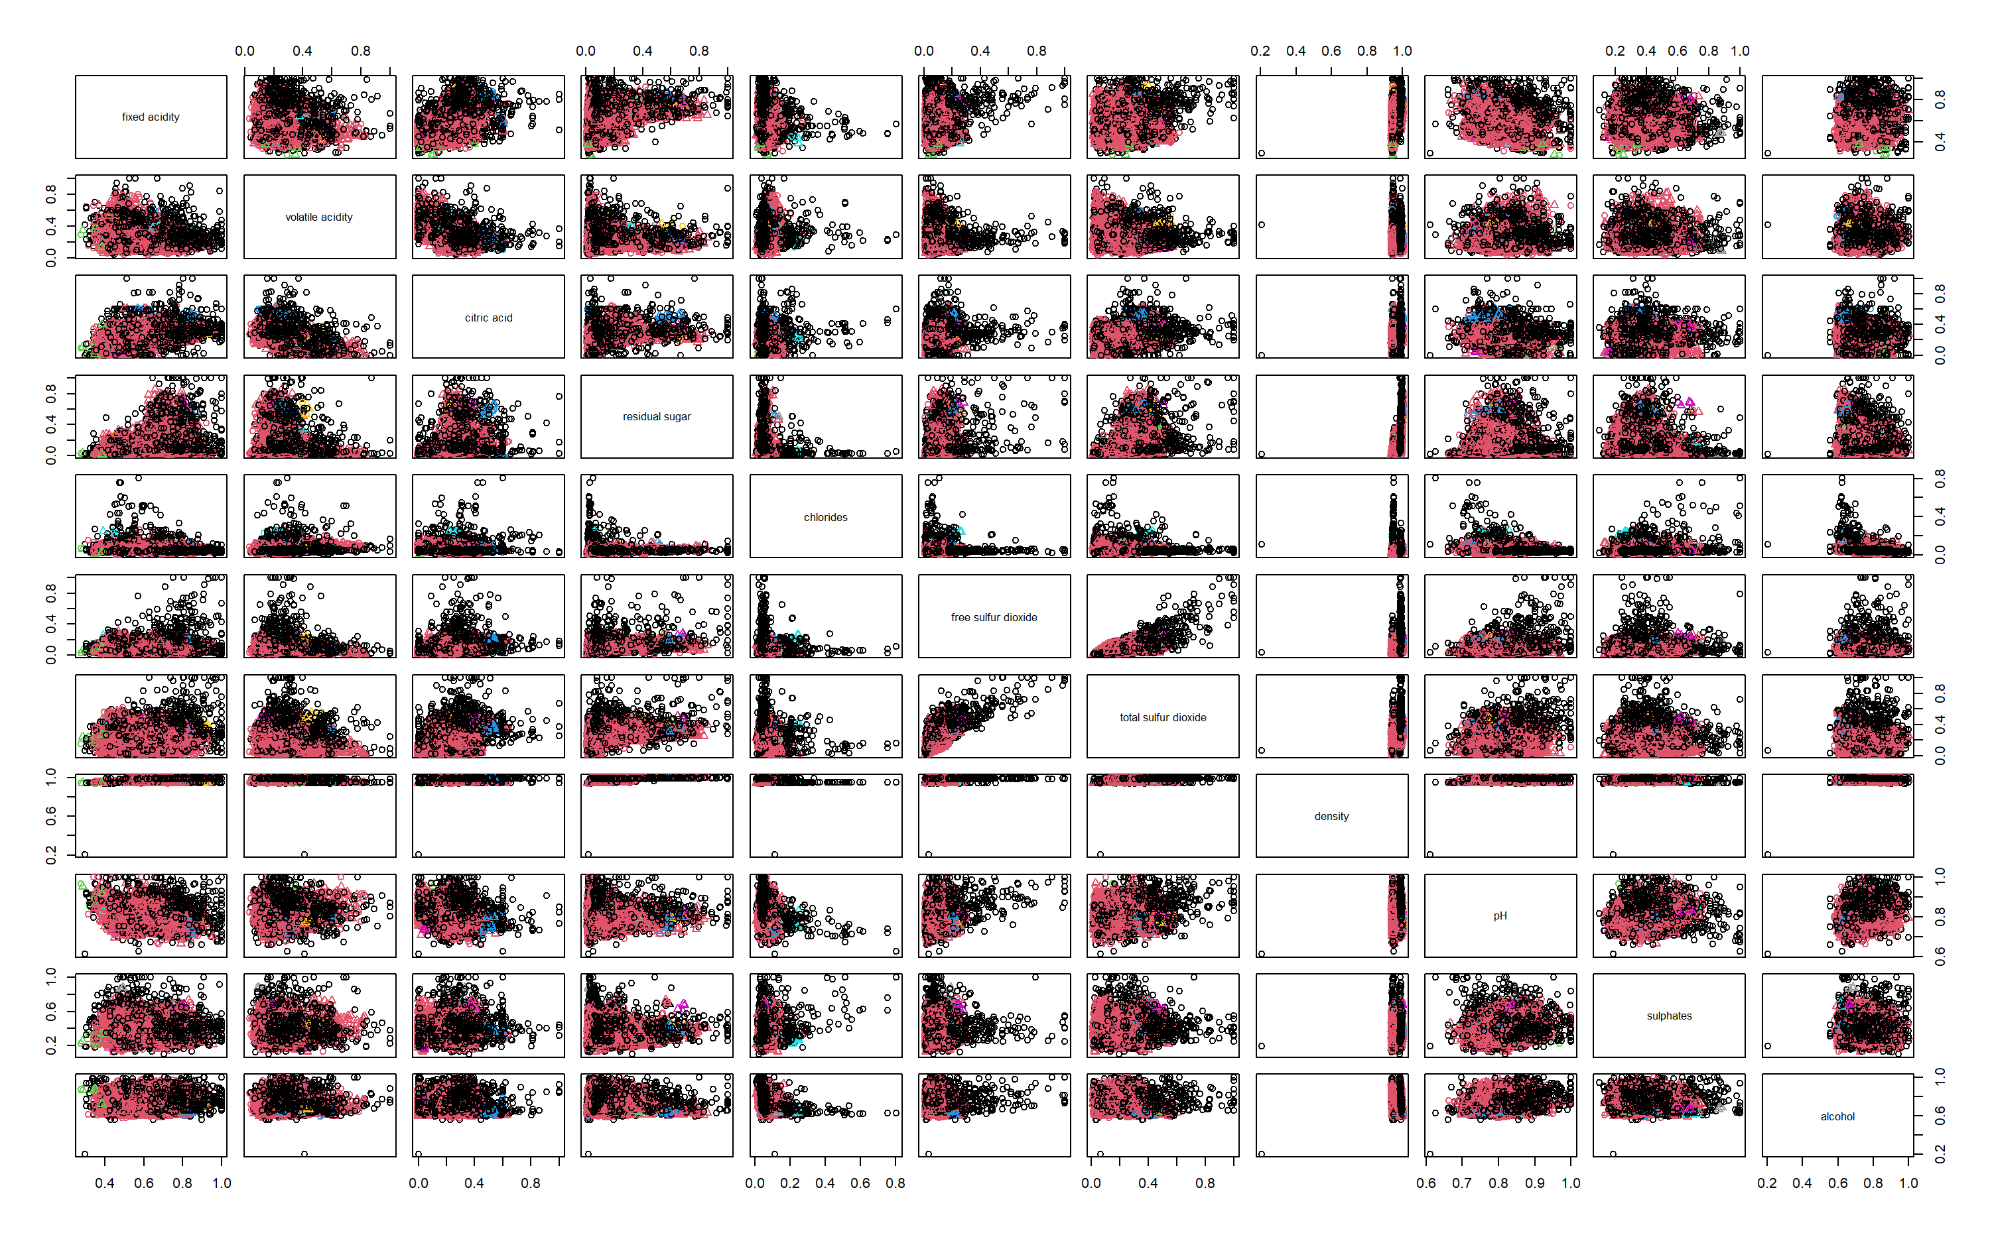
Density-Based Clustering

Slide 37
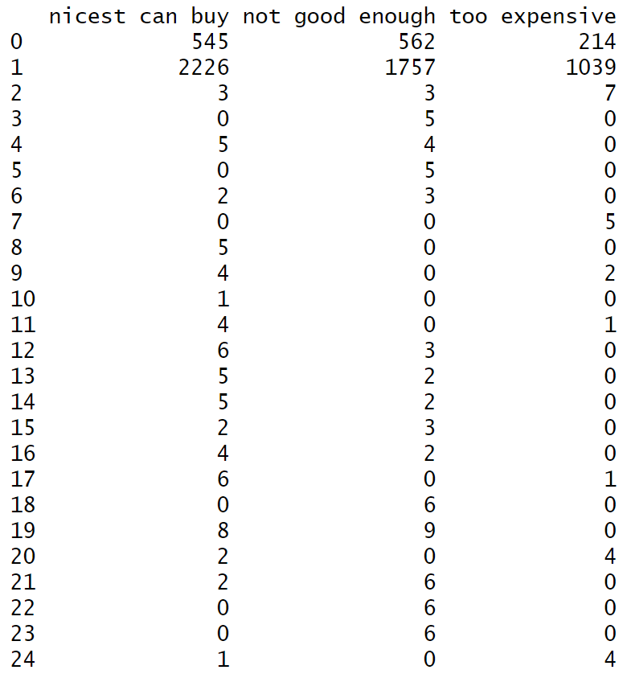
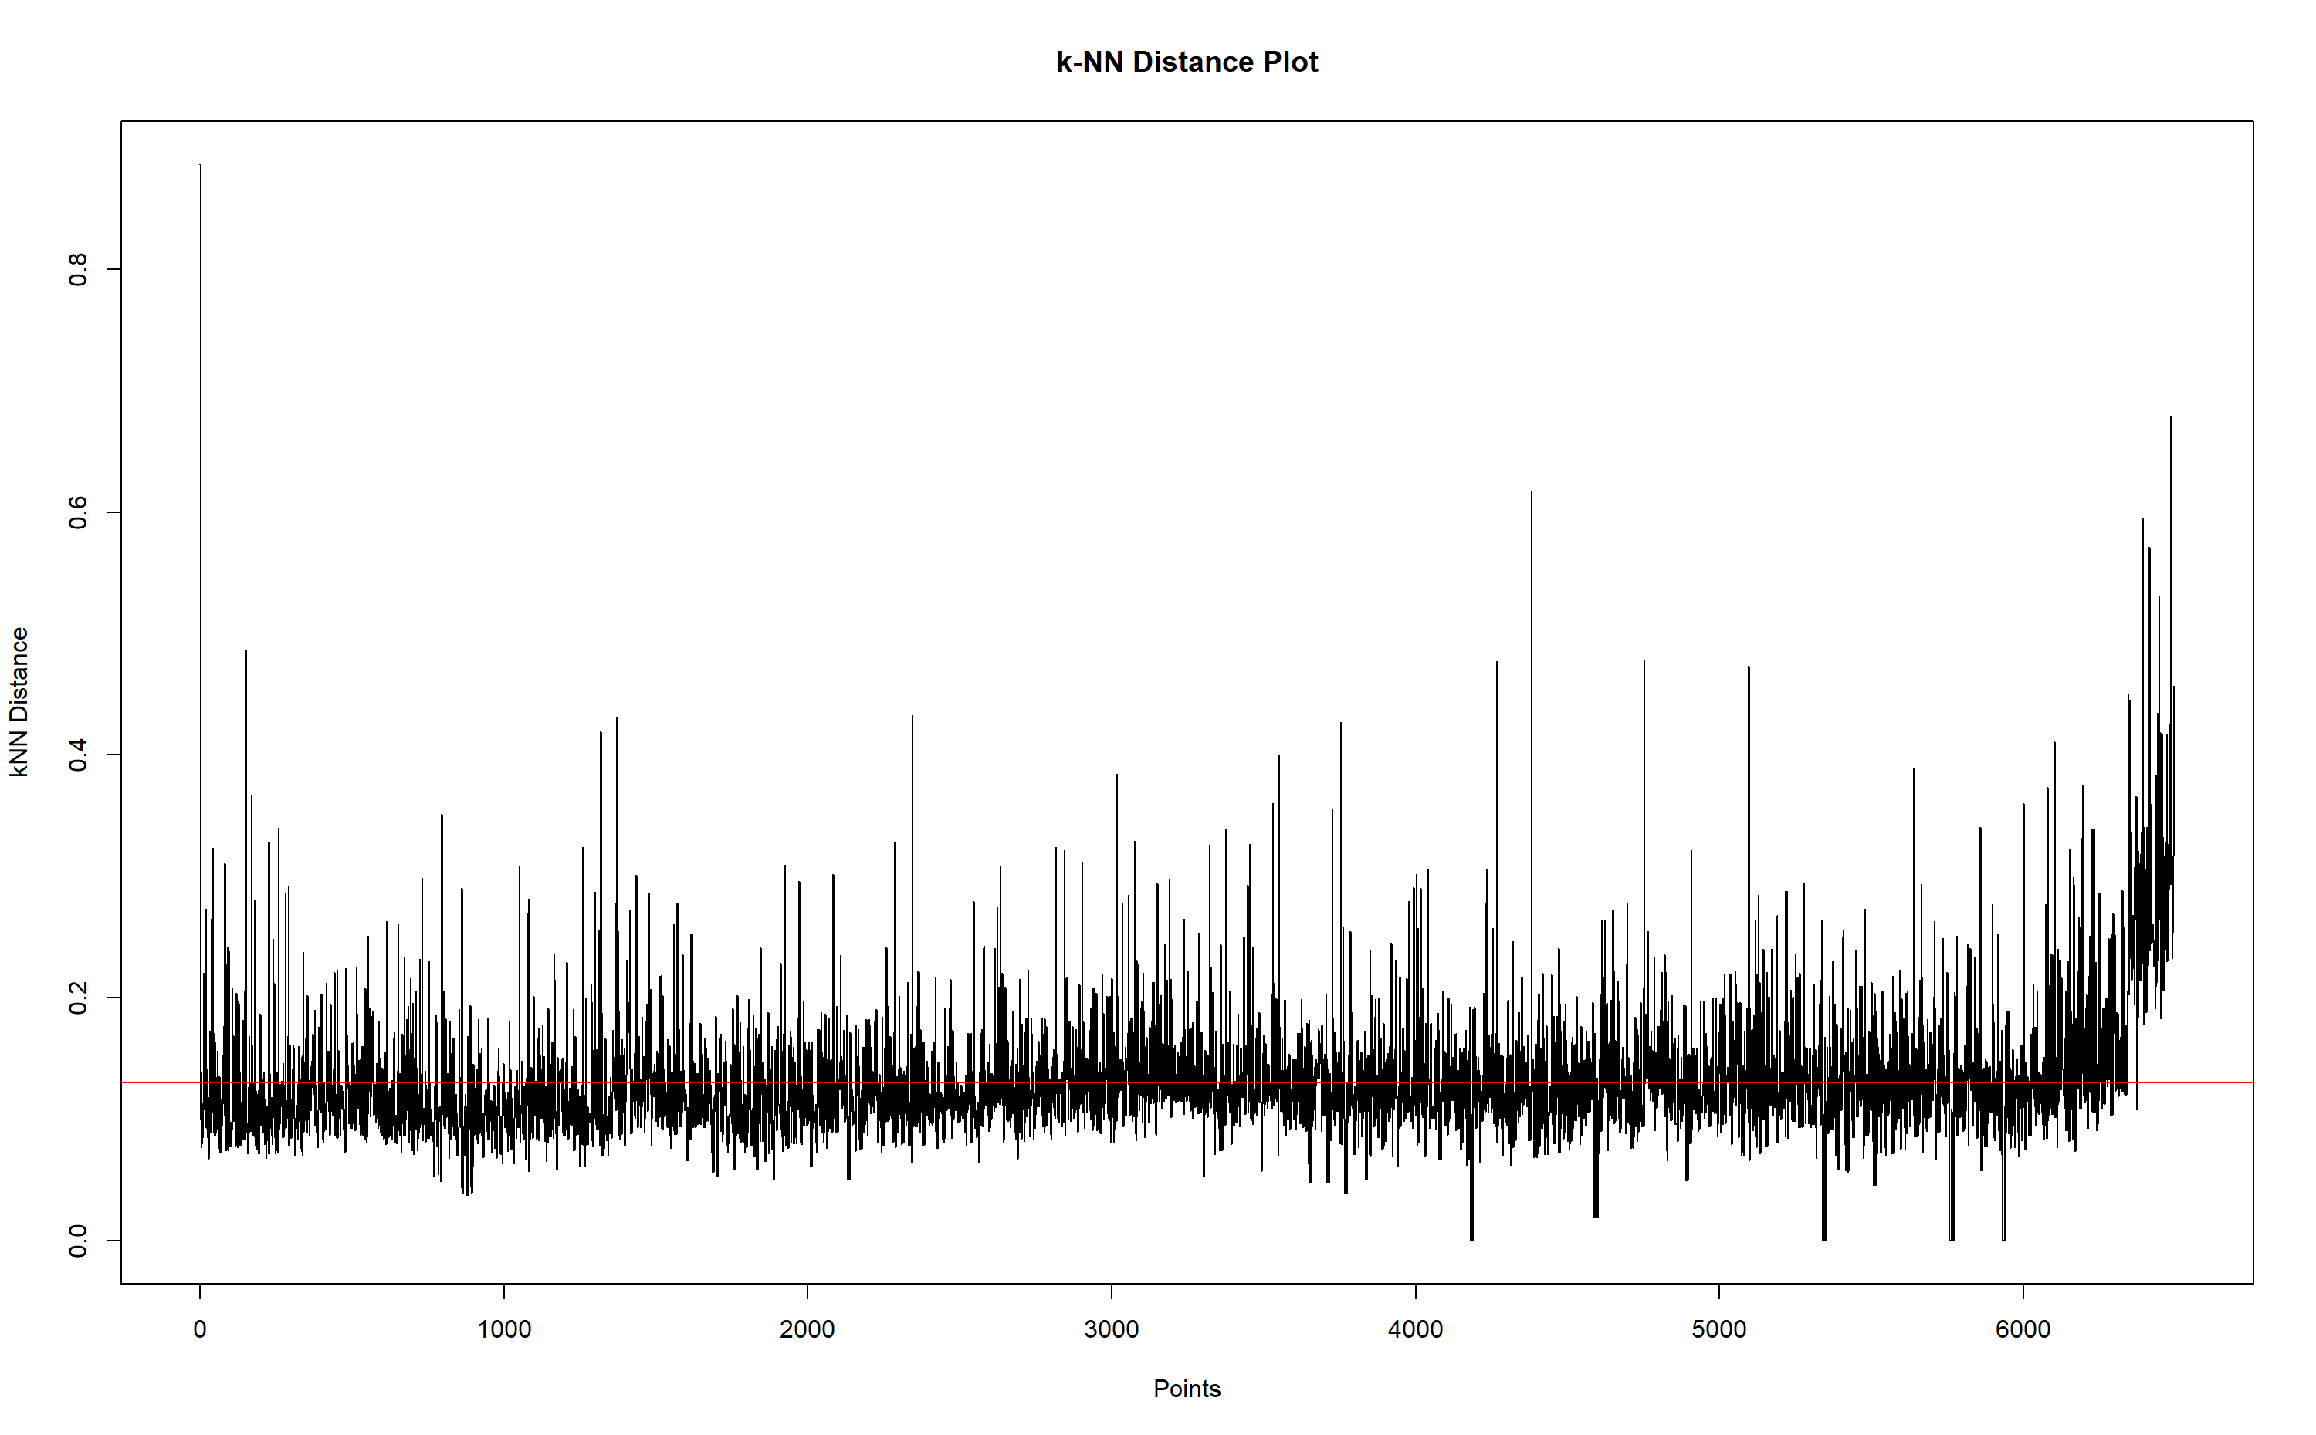
Density-Based Clustering

Slide 38
Association Analysis
Apriori

Slide 39
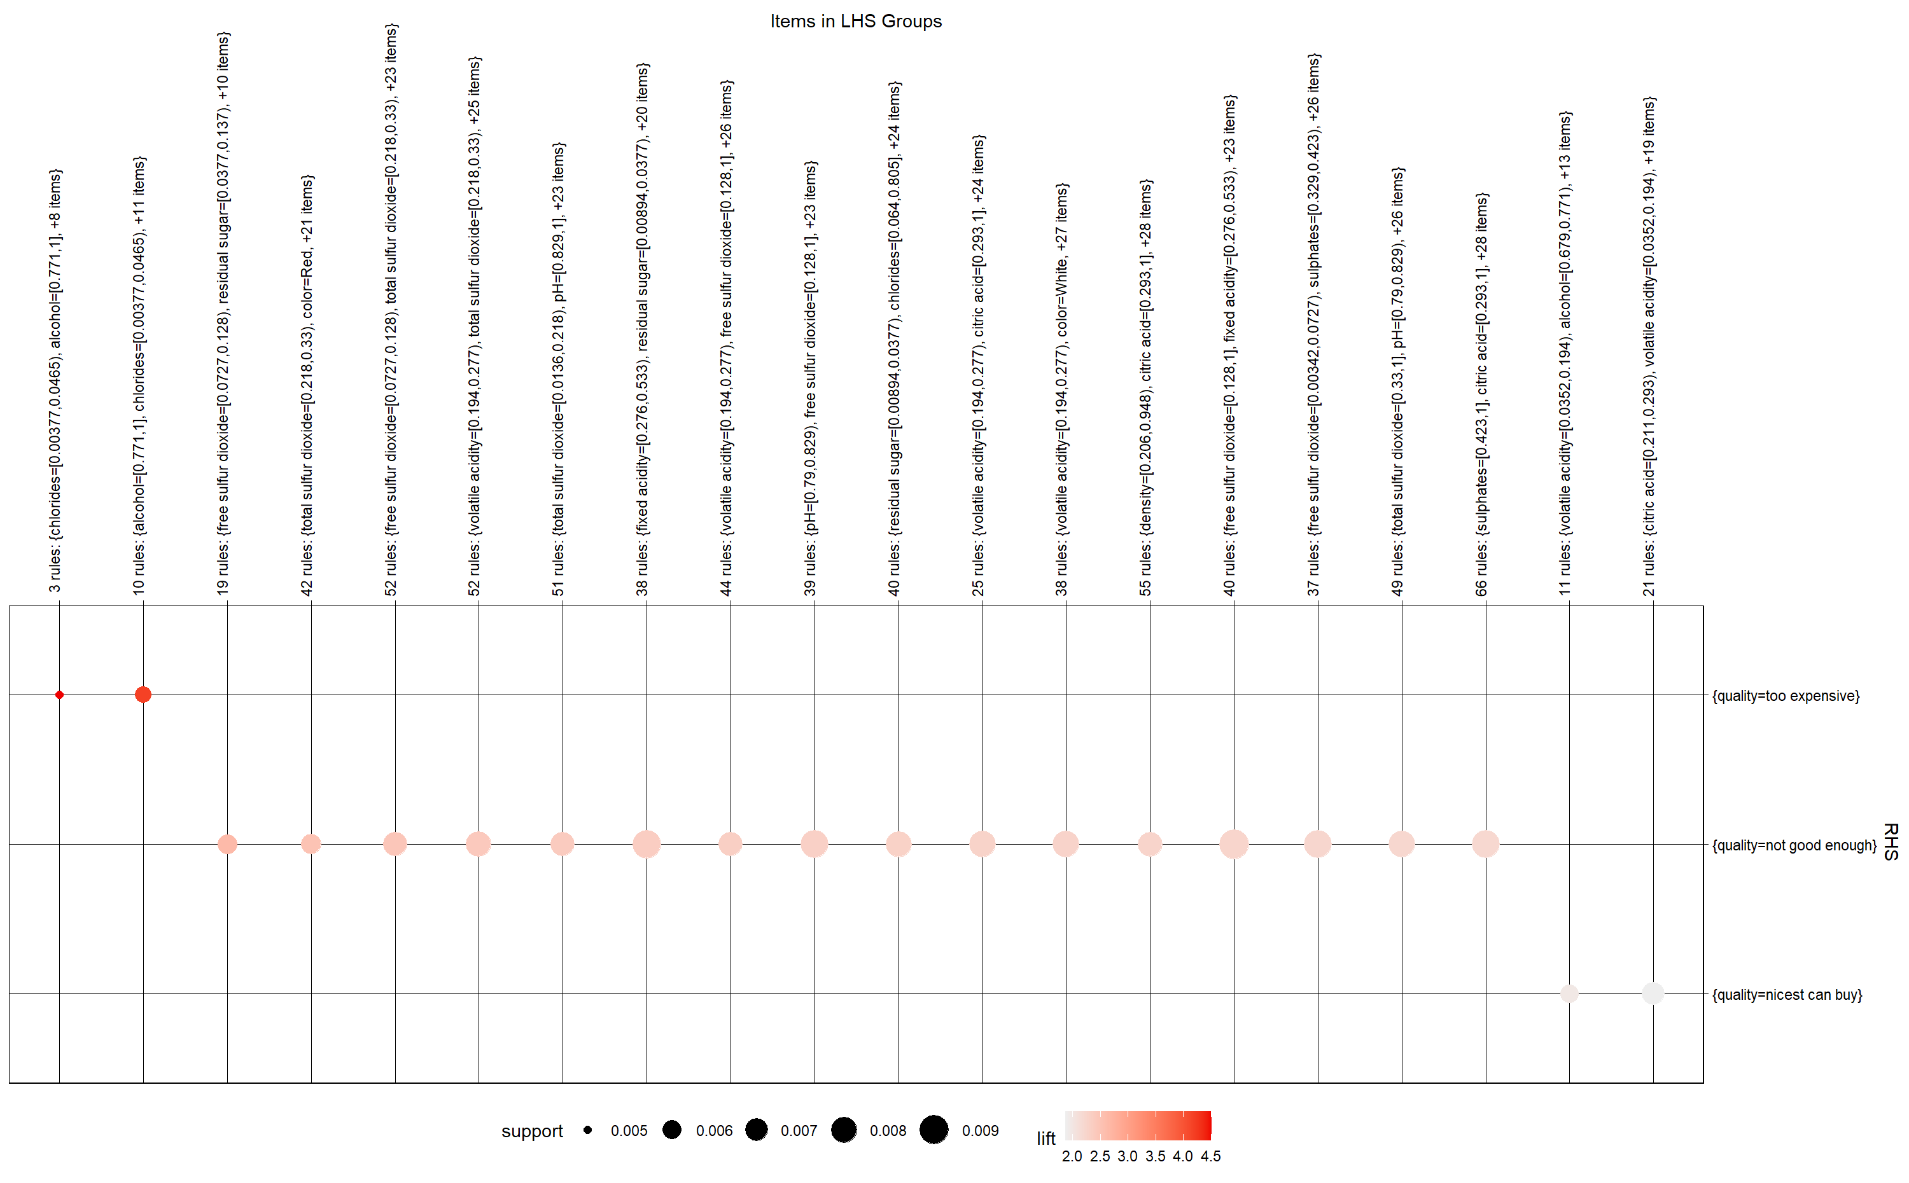
Apriori

Slide 40
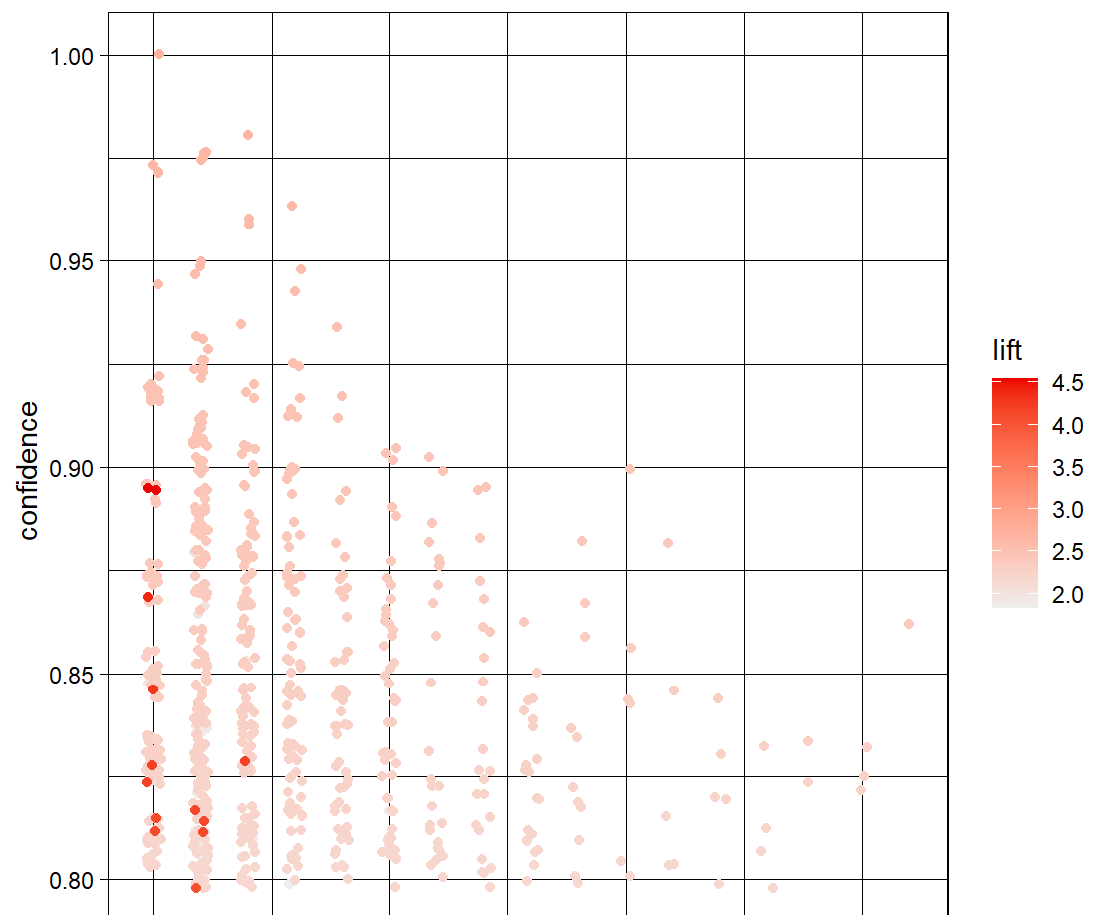
Apriori

Slide 41


Data Visualizations

Slide 42
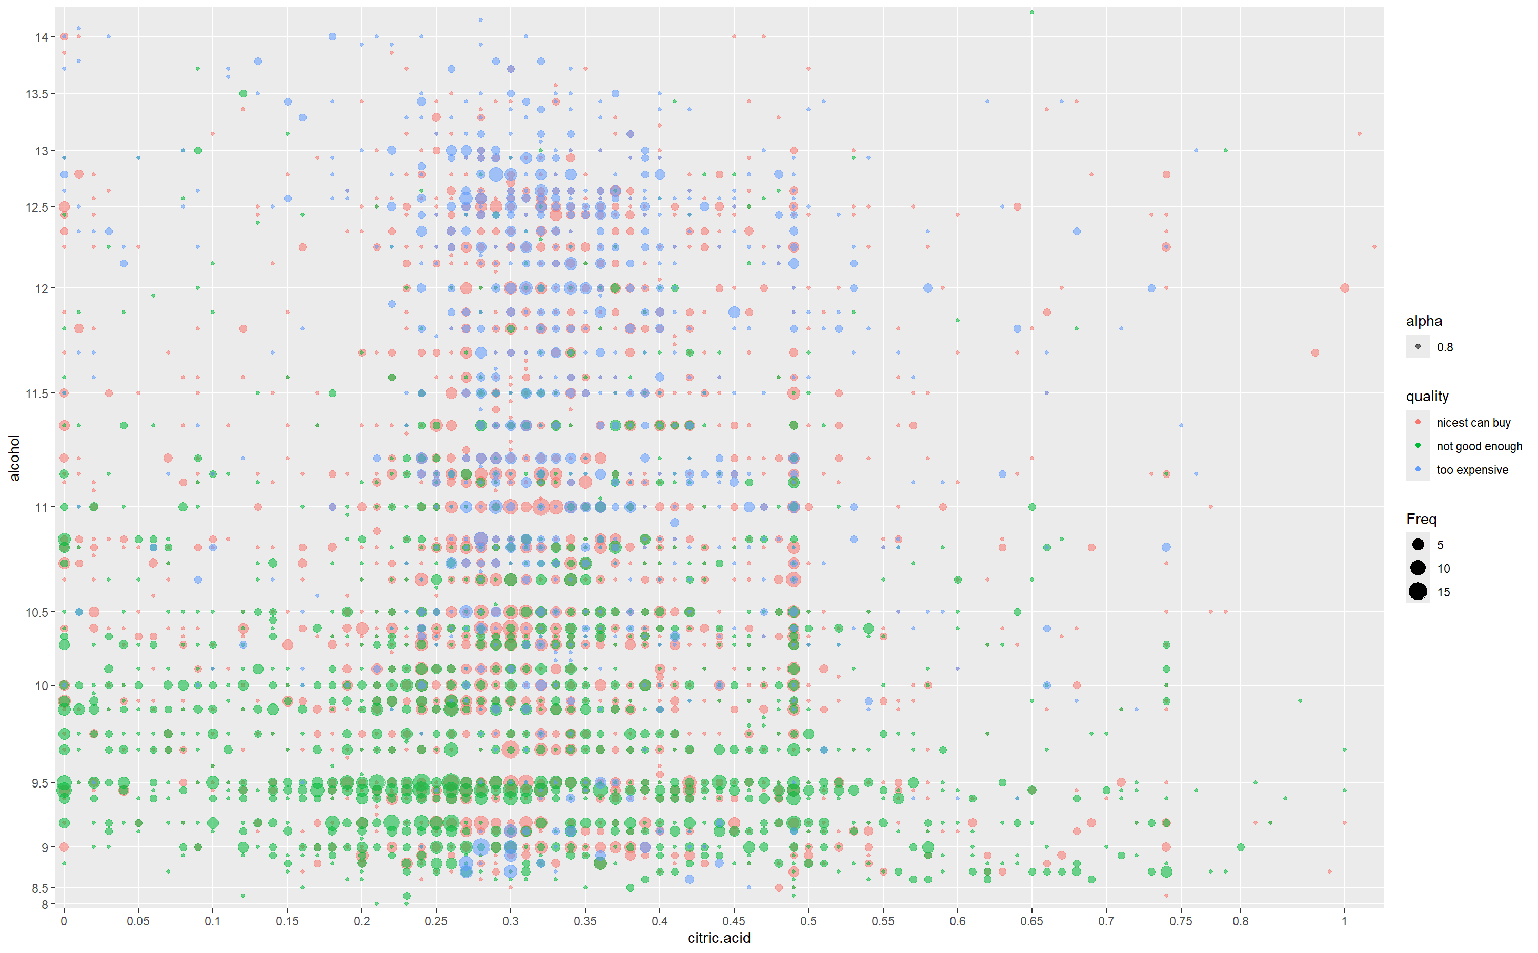
Alcohol vs. Citric Acid Scatter Plot
With Quality and Frequency

Slide 43
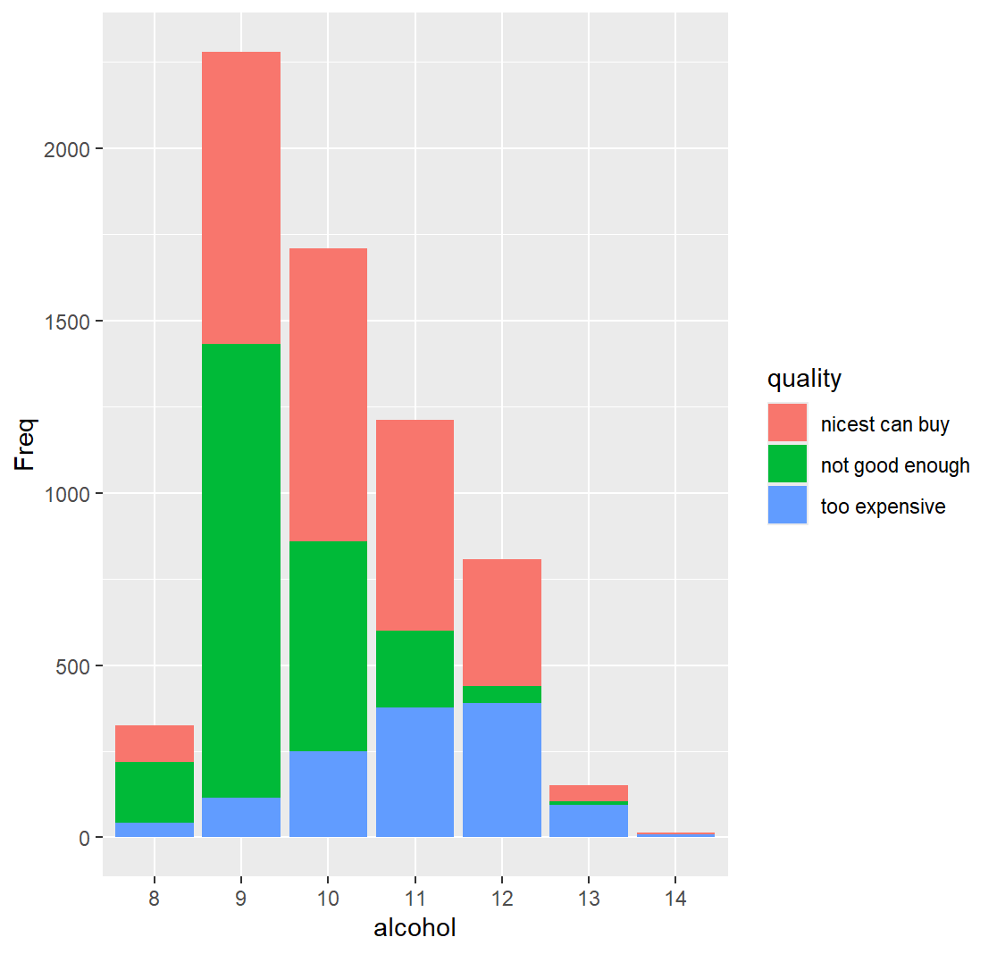
Alcohol Level Histogram
WITH QUALITY

Slide 44
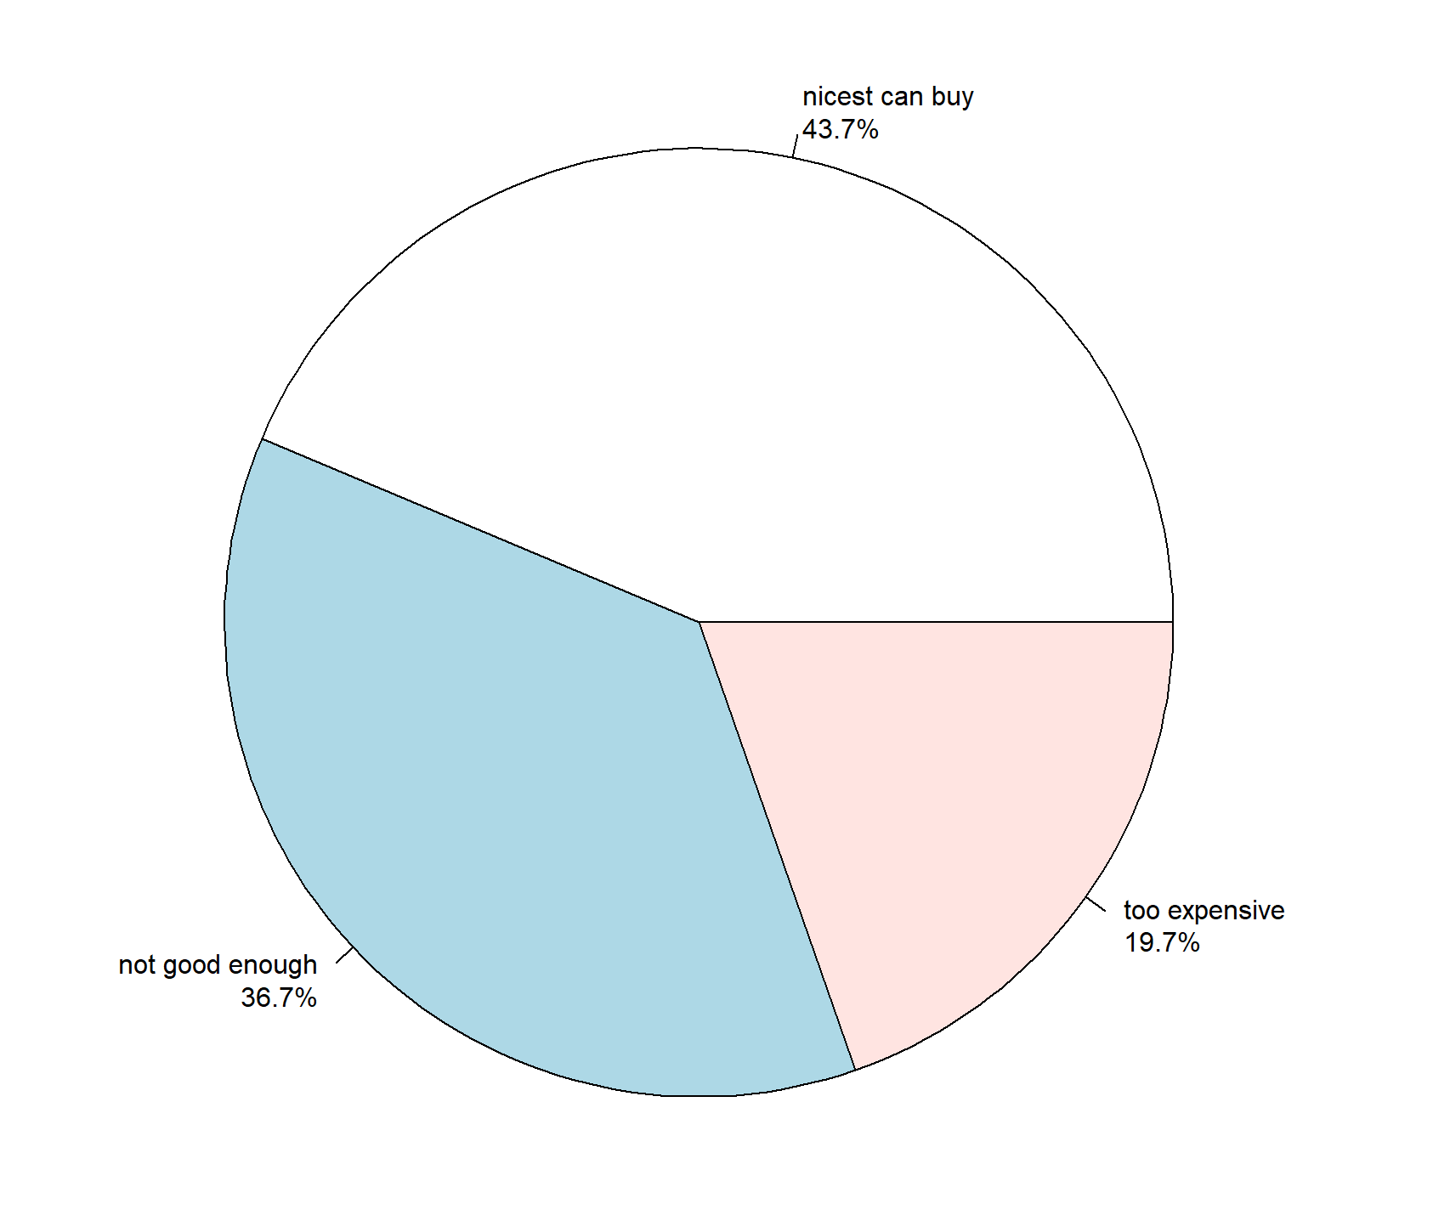
Quality Pie Chart

Slide 45



Final Conclusions

Slide 46
Best Performing Model
Random Forest
Decision Trees
Test data set (1918 rows)
Accuracy: 71.741%
rpart
Accuracy: 54.9%
ctree
Accuracy: 56.67%

Slide 47
Thank You For Your Time
Have a great summer

